Slide 1

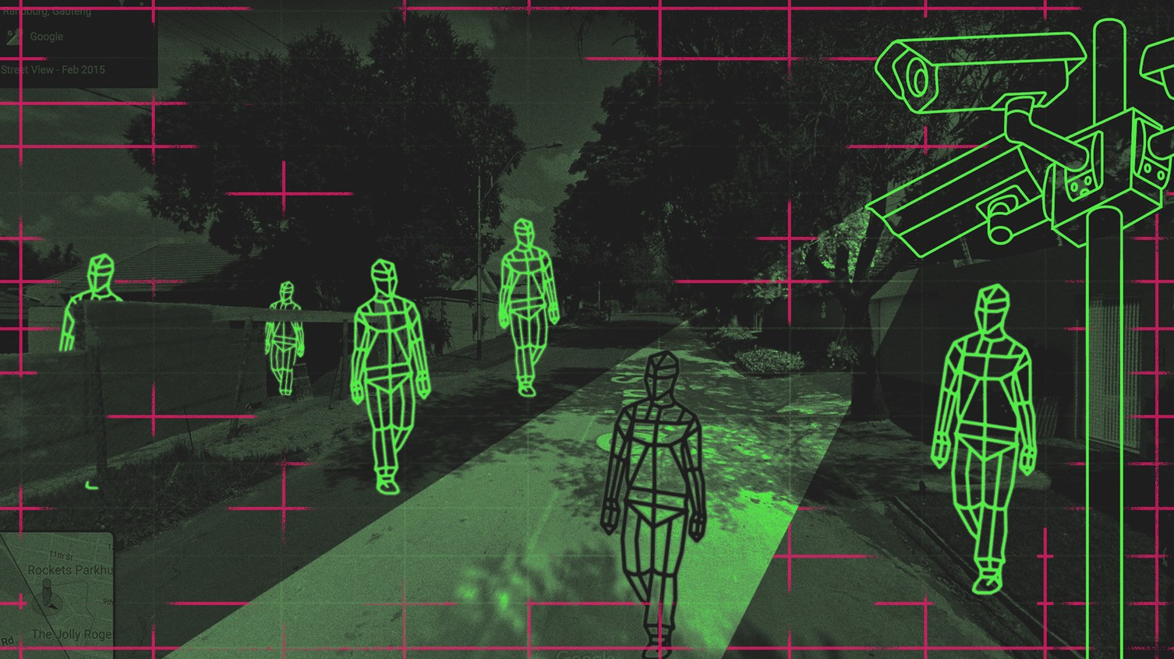
2020 - The Era of Artificial Intelligence
CCTV from dumb to smart
www.esse.me

Slide 2
Why Novus Intelligent CCTV System?
Face Recognition and Detection
People Counting / Tracking
Object Detection / Exception
Tripwire / Intrusion
Behavior Detection
Smart Search
Made in Europe
www.esse.me

Slide 3
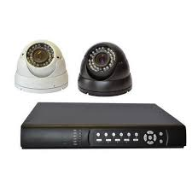

Face Recognition and Detection
What problems do you have in your classical/old system?
1. Does your current CCTV system
alert you when such suspicious
person tries to enter your premises?
2. Do you get notified when you
are visited by any VIP?
3. Could you track the above people
within your premises?
4. Can you use your current CCTV system for
surveillance as well as for automation?
www.esse.me

Slide 4

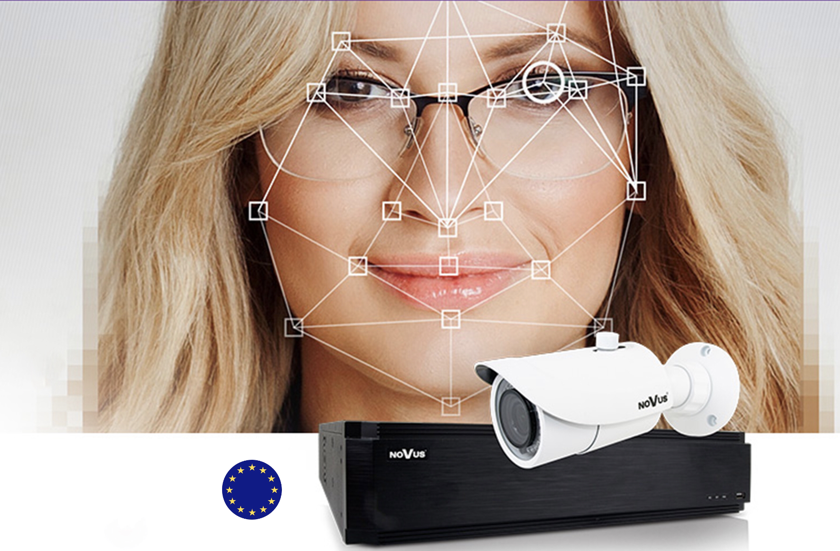
Face Recognition and Detection
What added value will you get using our system?
1. Be alerted when such dangerous person tries to get your
office/pharmacy/shop/house/factory/hotel/restaurant ...
2. Open your automatic gate when matching faces
3. Have people intelligent tracking
4. Sort your visitors into many categories e.g. Dangerous, VIP ...
Try to believe that all the above sophisticated feature can
be done using your smartphone!
www.esse.me

Slide 5
People Counting and Tracking
What problems do you have in your classical/old system?
1. Is your system capable of counting the traffic of incoming
and outgoing people?
2. Can you track a specific person through all your cameras,
and detect the taken path in sequence?
3. Does your system analyzes and detects suspicious human
behavior around and inside your premises?
www.esse.me

Slide 6
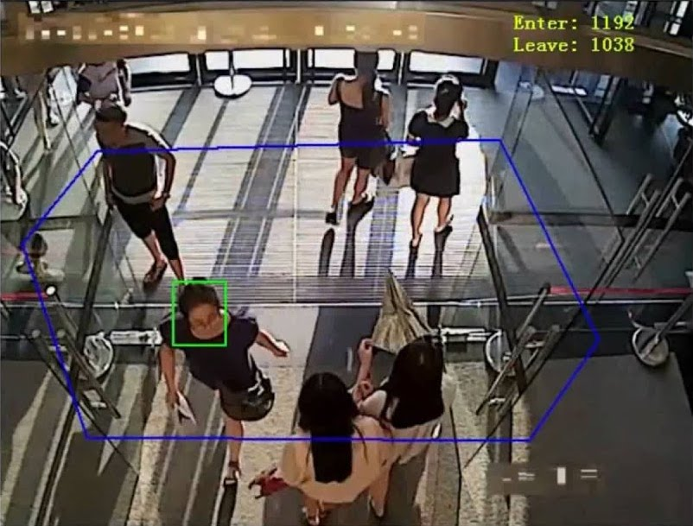
People Counting and Tracking
Capability of people counting
coming in/going out of the
store/mall/library and have
an idea of your visitors
attendance
2. Using the NVR smart search
you can track such person
around/within your premises
3. Using the AI of deep learning,
the system is capable of
analyzing people behavior and send you alarm when
abnormal behavior is occurring e.g. loitering, crowd density
www.esse.me

Slide 7
Object Detection / Exception
How many times:
Did you find a suspicious object and couldn’t verify
how, when and who did it?
2. An important item has gone missing and you couldn’t
track who took it?
3. You find a strange car in your private parking zone?
www.esse.me

Slide 8
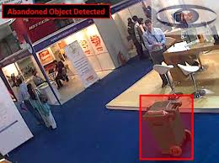
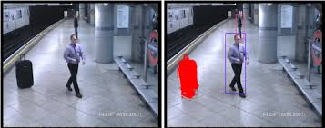
Object Detection / Exception
Thanks for the DWO, detection of the appearance or disappearance
of an object in a specific zone
e.g. Abandoned objects, missing objects
2. Thanks for the new smart search from Novus that allows you to
find easily and quickly who is using your private parking
www.esse.me

Slide 9
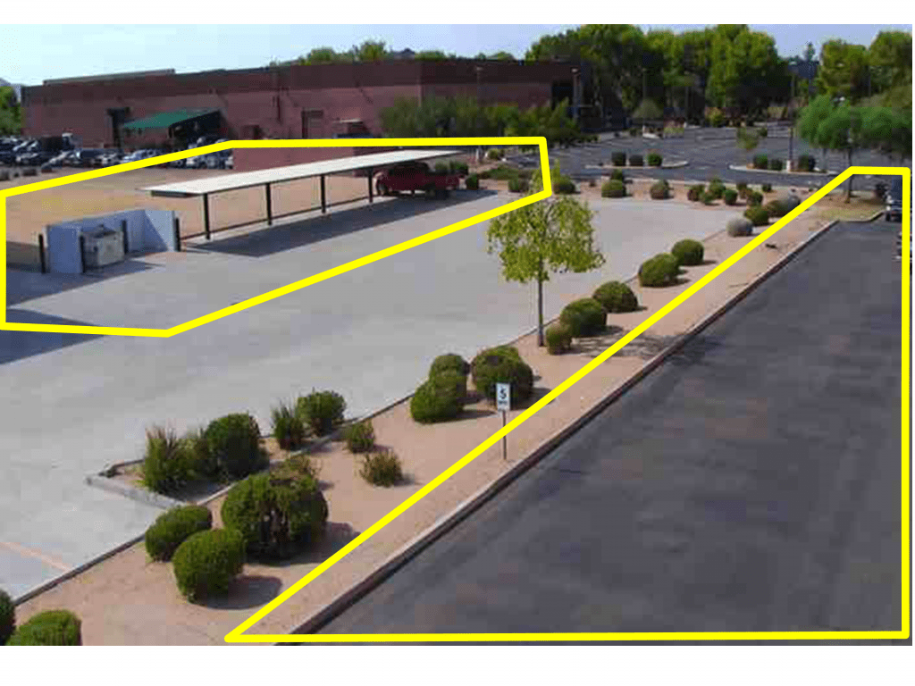
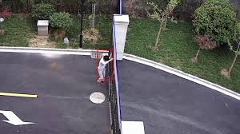
Tripwire / Intrusion
What problems do you have in your classical/old system?
Could you use your CCTV for surveillance as well as for Intrusion detection?
Thanks for the bi-directional virtual
fencing which can be able to differentiate
between incoming & outgoing movements,
therefore the dynamic low lux picture
image during night which affected the
recording issue in standard NVR won’t
affect NOVUS smart system.
www.esse.me

Slide 10
Smart Search
What problems do you have in your classical/old system?
1. Do you suffer guessing at what specific time something bad
occurred and you end watching for a long time to get the
scene you are looking for?
2. Can your current system give you the privilege to search for
an specific object or scene change?
3. Are you able to search for an exact person by his name or face?
www.esse.me

Slide 11

Smart Search
What benefits will you gain from our
system?
1. Thanks for the smart graphic search
of material menu function, from 1 month
up to 1 sec you can see all the scenes that
changed for a specific area/location/object
2. Thanks for the advanced face recognition
identifying an object resembling a human
face, in a specific zone, NOVUS will give you
the capability to search for a person by his
name or even match his face with any scene
existing in your recordings.
www.esse.me

Slide 12
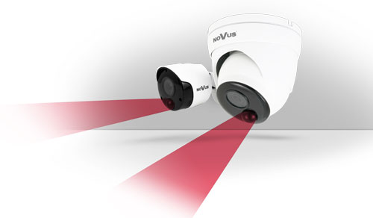
Extra features
In addition to all previous intelligent features, the user can specify
reaction from the system such as:
Sending an e-mail with information about the event and photo
Sending the image to the FTP server
Starting recording video stream on the SD card
Exporting the received result from the image recording and
analysis on the SD card can be done automatically every hour
to an XLS file
Finally thanks for the UNIQUE
elimination of unjustified alarms
in NOVUS systems with physical
motion detection (PIR)
www.esse.me

Slide 13
Mezher - Antelias - Lebanon
T + 961 4 717020
Dubai + 971 588318414
www.esse.me - info@esse.me

Slide 14
Thank you for your time
www.esse.me

